Slide 1
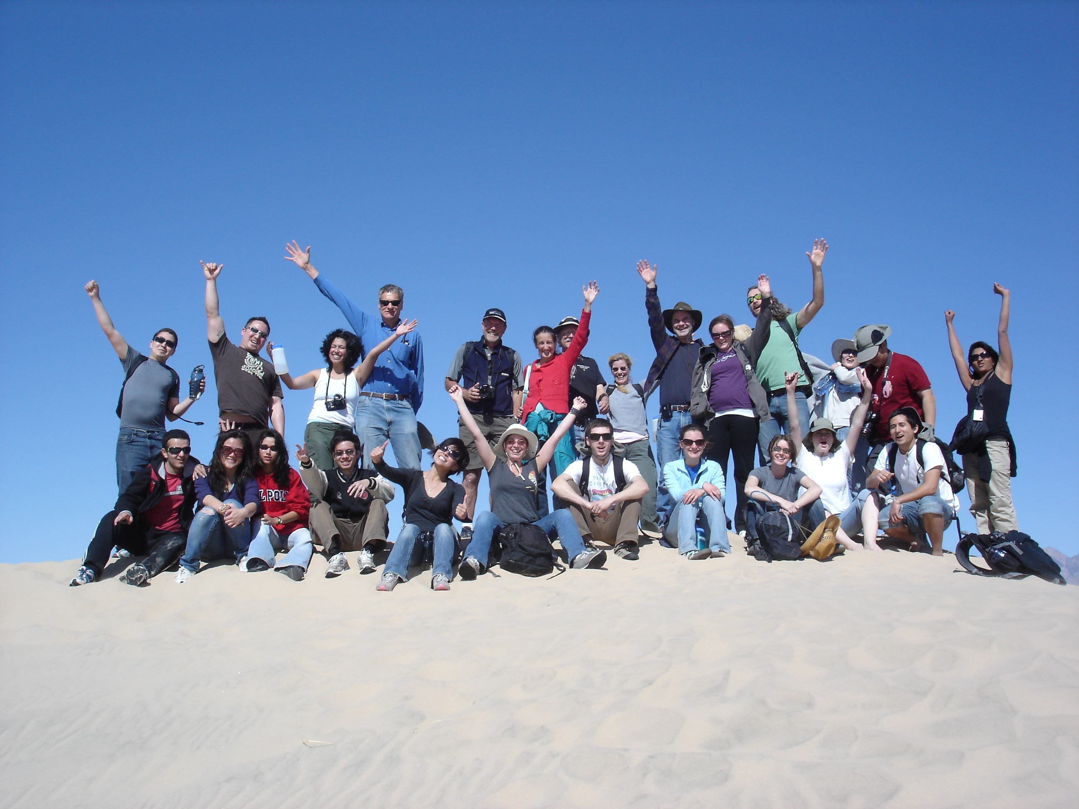
Spaceward Bound 2011
Mojave National Preserve
March 20-25

Slide 2
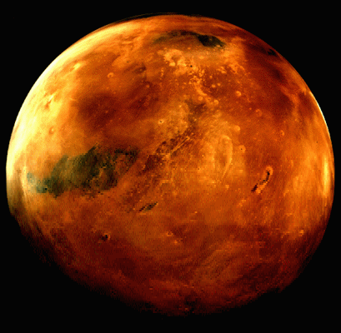
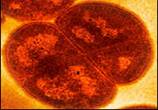
Details and Goals
Microbial Life in the Desert and its implications for Astrobiology
Headquarters: CSU Desert Studies Center in Zyzzx, CA
Funding: CSU MSTI program, NASA Ames (the Vans!)
~ 5 days days in the desert
doing science…astrobiology, microbiology, chemistry, math, engineering, and…
learning science…undergraduates, teachers, scientists
teaching science…training and retaining today’s teachers
Goals: to develop a Lesson Plan/Activity based upon Spaceward Bound
standards-based, 5E model, NASA-centric…

Slide 3
The Basic Plan
Headquarters: CSU Desert Studies Center in Zyzzx, CA
Research Field: Mojave National Preserve, Death Valley, and more
wake up around 7am…
have breakfast at HQ
have planning discussions to organize the days activities
break up into groups
grab prepared lunch-in-a-bag
visit differing sites during the day
conduct research during the day
return to HQ for dinner
participate in seminar-style research discussions
participate in discussions regarding teaching
prepare for next day
log entries into journal, Ning…

Slide 5
Research/Discussion Projects
Mojave National Park, Death Valley, Stromatolites, sampling of differing soils to measure impacts of environmental conditions and water content on microbial survival.
Soil microbiology; do soil microorganisms possess similarities to those isolated in spacecraft assembly rooms. how is the presence of these microorganisms confirmed? what types of microorganisms exist in the soil?
Biological Soil Crusts; do these structures grow in predictable patterns? Are these structures analogs for Life on Mars or Europa?
Bio-Batteries; microorganisms from the mud of Soda Lake will used to make a battery.
Rovers & Robots; can these devices traverse over the desert landscape? can images of the traversed land be captured and saved?
Balloons; can underground caves be detected by thermal imaging from balloons?

Slide 6
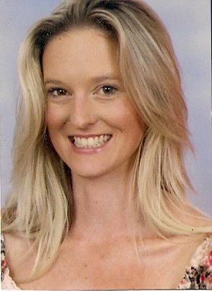
Nicolette Hilton
I am a 2010 Churchill Fellow and I have made improving the learning culture of science education in Australia my project. I am spending 7 weeks in the US collecting resources, ideas and inspiration to bring back to Australia and share with my teaching peers. Over the past 18 months I have disseminated the Spaceward Bound program through workshops and presentations at national and international conferences and now it is part of our national Teacher Earth Sciences Education Program (TESEP).

Slide 7
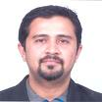
Parag Vaishampayam
On field Instrumentation pipeline for bio-burden detection, DNA extraction and estimation.
Bacillus pumilus spores hitchhiking to International Space Station – Survivability after exposure to space and simulated Martian conditions

Slide 8
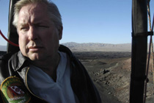
Jim Thompson
We plan to go back to Cima lava tubes and conduct around the clock 24 hours thermographic shots every 10 minutes from 150 m from the entrance of the main tube to the caldera. With the previous four years of thermographic images from 100 m, and last year from 150 m we plan to finish a paper on the best times over a 24 hour period for thermographic images to be taken of lava tubes.
We would welcome any teachers or students to assist us again this year,.

Slide 9
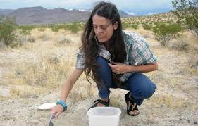
Rosalba Bornaccorsi
At this stage, we are working on a high fidelity analog site (of MSL 11 landing), the Ubeheve Volcanic Field (a caldera field).
We are focused on clay minerals and sedimentary environments, the clay cycle in connection with habitability aspects. Specifically, we want to understand of role of (liquid) water/climate, and time scales involved in weathering processes and conducive to life (as we know it). We have sensors there for monitoring soil moisture and a rain gauge to monitor rainfall and measure sedimentation rate of clay rich materials in intracrater fills.
My area of expertise is interdisciplinary (environmental sciences, sedimentology and in connection with first order microbiological aspects e.g., looking at the habitability potential of geological environments with living biomass assay.

Slide 10

Keith Schubert
Scotch on the Rocks
As I am Scottish, and I will be talking about growth of extremophiles on
rocks. If you want a more serious sounding title let me know. :)
I am planning on doing mud batteries and CA extremophile imaging.
microbial mathematics, it is technically called cellular automata.

Slide 11
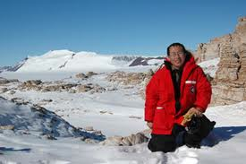
Henry Sun
I can discuss endolith, hypolith, and soil crusts. No students or assistants.
One possibility is to go out in the morning, use my penetrometer, collect samples. In the afternoon, we work in the lab. I will bring a PAM flourometer. It would be good to have access to their compound light microscope (not dissecting microscope).

Slide 12
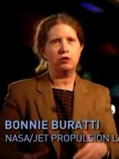
Bonnie Buratti
The activity would be a lecture on "Water worlds in the outer
Solar System", based on recent results from Cassini and other
missions on liquid water and methane and life-sustaining
habitats, with a naked eye (or binoculars) "star party" at night
to identify some of the relevant planets.

